Slide 1
EFSPI Summary
8th EFSPI RegStat Workshop program
09-Feb-2024
8th EFSPI Regulatory Statistics Workshop
13th-14th September 2023
Zehui Bai, Senior Biostatistician - ICON

Slide 2

Introduction
EFSPI
European Federation of Statisticians in the Pharmaceutical Industry
您的内容打在这里，或者通过复制您的文本后，在此框中选择粘贴，并选择只保留文字。在此录入上述图表的综合描述说明.
EFSPI is engaged in statistical aspects of research, development, production, and surveillance of drugs and medical devices

Slide 3
Outline of Workshop
8th EFSPI Regulatory Statistics Workshop
13th -14th September 2023
Basel Switzerland
2-day workshop, either in-person attendance (~300 this year) or virtual (>500)
5 main sessions, plus short topic sessions
Representation from at least 6 national agencies and EMA, plus a few presentations by FDA
Slide: https://efspieurope.github.io/workshop/
The workshop will take place 11/12th September 2024 again in the beautiful Biozentrum in Basel.

Slide 4
Session 1 – Regulatory and HTA Update
Kristin Karlson
EMA Methodology Working Party update
1
Jupiter
Jupiter is a gas giant and also the biggest planet in the Solar System
Sesson 1
Eftychia-Eirini Psarelli
EMA update on submission of individual patient data from clinical trials
Jupiter
Jupiter is a gas giant and also the biggest planet in the Solar System
2
David McConnell
Update on joint HTA work under the EU HTA Regulation
Jupiter
Jupiter is a gas giant and also the biggest planet in the Solar System
3
Notes:
Kristin Karlsson (Swedish Medical Products Agency, Uppsala University, EMA, Vice-chair MWP) Eftychia-Eirini Psarelli (University of Liverpool, EMA)
David McConnell (Statistician National Centre for Pharmacoeconomics, Ireland, Methodology Subgroup of HTA CG)
EU Health Technology Assessment (HTA) Regulation

Slide 5
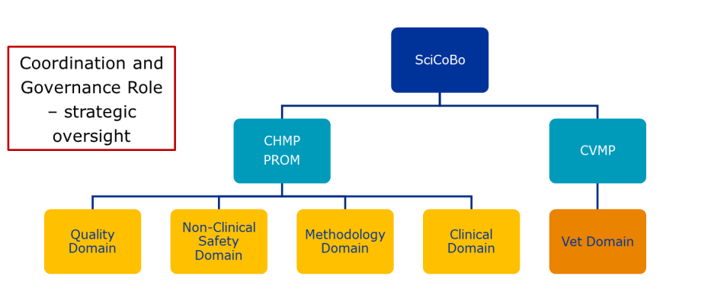
Session 1 – Regulatory and HTA Update
Kristin Karlson (Swedish Medical Products Agency): EMA Methodology Working Party update
Recently reorganised
Scientific Coordination Board
Notes:
The MWP's tasks include:
providing product-related support when requested by EMA Committees and the Scientific Advice Working Party;
engaging with stakeholders including international regulators, associations of pharmaceutical companies, and patient and healthcare professional organisations;
preparing, reviewing and updating guidelines and concept papers;
providing training and workshops to assessors.
Scientific Coordination Board:
this board is responsible for coordinating the work of the Committee for Human Medicinal Products (CHMP)
Committee for Veterinary Medicinal Products (CVMP).
Quality Domain:
This domain oversees the standards of quality for medicines, including aspects of manufacturing processes, ingredients, and packaging.
Non-Clinical Safety Domain:
Focuses on the non-clinical safety evaluation of medicines, covering studies on potential toxicities and side effects that are non-clinical in nature.
Methodology Domain:
This area concentrates on developing and maintaining the scientific methods and standards used to evaluate medicines, such as clinical trial design, statistical methods, modeling and simulation, real-world evidence, artificial intelligence diagnostics, and other related disciplines.
Clinical Domain:
Specializes in the clinical efficacy evaluation of medicines, ensuring that clinical trials and assessments are in line with clinical practices and patient needs.

Slide 6
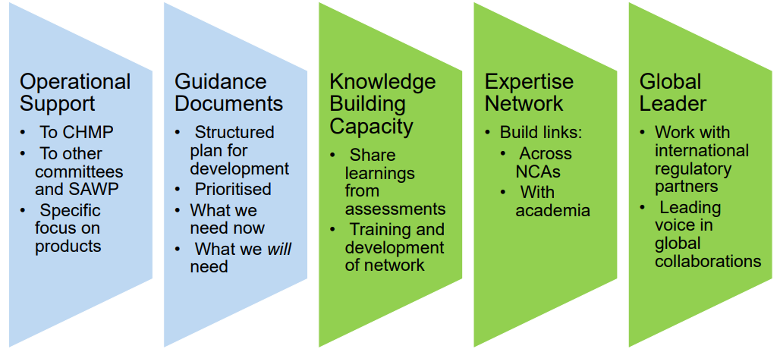
Session 1 – Regulatory and HTA Update
Kristin Karlson (…continue)
Essentially a hub with expanded network of experts
Consolidated 3-year work plan for the Methodology Working Party (MWP) https://www.ema.europa.eu/en/documents/work-programme/consolidated-3-year-work-plan-methodology-working-party-mwp_en.pdf
Strategic Goals
Notes:
Operational Support:
To CHMP: Providing support to the Committee for Human Medicinal Products.
To other committees and SAWP: Assisting other committees and the Scientific Advice Working Party, focusing on products that may require more specific or intensive evaluation.
Specific focus on products: Concentrating on particular medicinal products that may need additional attention or resources.
Guidance Documents:
Structured plan for development: Establishing a clear and organized approach for the creation and updating of guidance documents.
Prioritized: Ensuring that the most critical guidance documents are developed first, according to the current needs and priorities.
What we need now: Identifying and addressing immediate requirements in guidance to ensure current regulatory processes are up-to-date and effective.
What we will need: Anticipating future needs and preparing for upcoming challenges or changes in the regulatory landscape.
Knowledge Building Capacity:
Share learnings from assessments: Disseminating findings and insights gained from regulatory assessments to improve future processes.
Training and development of network: Focusing on the education and professional development of the network's members to enhance their regulatory capabilities.
Expertise Network:
Build links across NCAs: Establishing and strengthening connections among National Competent Authorities (NCAs) for better coordination and sharing of expertise.
With academia: Collaborating with academic institutions to incorporate the latest scientific research and methodologies into regulatory practices.
Global Leader:
Work with international regulatory partners: Engaging with regulatory bodies from around the world to harmonize standards and practices.
Leading voice in global collaborations: Taking a prominent role in international discussions and initiatives to shape the global regulatory framework.

Slide 7
Short Topics
Janssen
Novartis
Formal statistical requirements for a pivotal trial to support approval of a combination drug
What’s the rule for the pool?
Novartis
Short topics
Roche
Use of RWE in drug labelling
Surrogate endpoints - can EMA and EU HTA align on common standards?
Bayer
Roche
Hierarchical Composite Endpoints for Chronic Kidney Disease Trials
Data Quality issues in IITs
Notes:
6 questions (hypothetical) for a panel representing various regulators
Interesting discussions, with considerable openness in response from panel

Slide 8
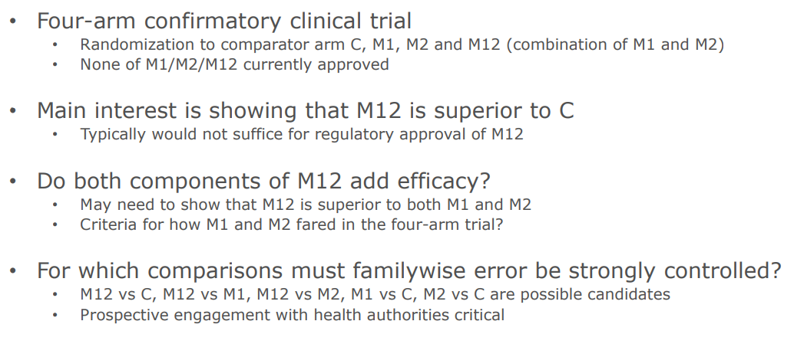
Short Topics – Janssen (Fredrik Öhrn)
Notes:
Fredrik Öhrn, PhD Senior Scientific Director, Quantitative Sciences Consulting
Frederick Ern from Jansen (Johnson and Johnson) presents a question about obtaining approval for a combination drug through a trial with four arms: a control, two monotherapies (M1 and M2), and a combination of the two (M1+M2). His main concern is demonstrating the superiority of the combination over the control and potentially over the monotherapies, acknowledging the regulatory challenges of doing so based solely on such comparisons.

Slide 9
Short Topics – Janssen (Fredrik Öhrn)
M1+M2 is superior not only to the control arm but also to each of the monotherapies individually.
M1+M2 vs. C
M1+M2 vs. M1 and M1+M2 vs. M2
M1 vs. C and M2 vs. C
Notes:
indicates that to support the regulatory approval of the combination therapy M1+M2, it may be necessary to demonstrate that the combination adds efficacy beyond what each of the monotherapies, M1 and M2, offers. This involves showing that M1+M2 is superior not only to the control arm but also to each of the monotherapies individually. The rationale behind this approach is to prove that each component of the combination contributes significantly to the overall efficacy, thereby justifying the use of the combination over the use of either component alone.
This requirement is consistent with regulatory expectations for combination therapies, where the added complexity of combining drugs mandates a clear demonstration of added benefit. It ensures that the combination therapy provides a meaningful therapeutic advantage, such as increased efficacy or reduced side effects, compared to the monotherapies.
M1+M2 vs. C: This comparison is critical to establish the efficacy of the combination therapy over the control, serving as the primary basis for regulatory approval.
M1+M2 vs. M1 and M1+M2 vs. M2: These comparisons are necessary to demonstrate that the combination therapy is superior to each monotherapy, indicating that each component adds to the efficacy of the combination.
M1 vs. C and M2 vs. C: While these comparisons may be of interest, especially if M1 and M2 are not yet approved therapies, the primary focus is often on the combination therapy. However, demonstrating that each monotherapy is effective over control can support the rationale for their combination.
The requirement to control FWER in these comparisons ensures that the conclusions drawn from the trial are reliable and not a result of chance due to multiple testing. Typically, the most stringent controls are applied to the primary endpoints, particularly those comparisons that are essential for the trial's objectives (e.g., M1+M2 vs. C, M1+M2 vs. M1, M1+M2 vs. M2).
Participants discuss the importance of demonstrating the individual contributions of M1 and M2 to the efficacy of M1+M2, as well as the complexities involved in such a trial design, including multiplicity control and interim analysis.
They emphasize the need for a strong standard of evidence, especially for combination drugs, and the importance of engaging with health authorities early on.

Slide 10
Session 2 – Synthetic and Other Baseline Covariates
Venus
Die Venus ist fast so groß wie die Erde
BfArM, EMA
Covariate Adjustment: Traditional principles and challenges by new approaches
Genentech Roche
Strategic considerations and value of covariate adjustment
Session 2
Synthetic and other baseline covariates
FDA
Adjusting for covariates in randomized clinical trials for drugs and biological products
Notes:
Andreas Brandt (BfArM, EMA)
Courtney Schiffman (Genentech Roche) Daniel Rubin (FDA)

Slide 11
Session 2 – Synthetic and Other Baseline Covariates
Andreas Brandt (BfArM, EMA): Covariate Adjustment: Traditional Principles and Challenges by New Approaches
Topic: Explored traditional principles of covariate adjustment and the challenges introduced by newer approaches, such as machine learning (ML).
Prognostic Covariate Adjustment (PROCOVA)
Notes:
Mentioned a prognostic score for outcome based on historical data, highlighting its potential lack of clinical interpretation due to its "black box" nature --- concerns about transparency and interpretability.

Slide 12
Session 2 – Synthetic and Other Baseline Covariates
Courtney Schiffman (Genentech Roche): Strategic Considerations and Value of Covariate Adjustment
Topic: Focused on the strategic importance and value of covariate adjustment in enhancing the robustness and efficiency of clinical trial analyses.
Marginal Average Treatment Effects & Super Covariate
Notes:
Discussed using a super covariate derived from a prognostic model to refine the estimation of marginal average treatment effects, potentially increasing the effective sample size (ESSI) and thereby the power of the study.

Slide 13
Session 2 – Synthetic and Other Baseline Covariates
Daniel Rubin (FDA/CDER/OTS/OB/DBIV): Adjusting for Covariates in Randomized Clinical Trials for Drugs and Biological Products
Topic: Provided an overview of the final FDA guidance on covariate adjustment issued in May 2023, covering practical and regulatory considerations.
Machine Learning & Prognostic Indexes
Notes:
Key Points: Emphasized the importance of aligning covariate adjustment strategies with the trial's estimands, careful selection of covariates, considerations for sample size and the use of permutation tests. Highlighted the distinction between "actual" vs "randomized" strata and the role of inverse probability weighting (IPW) in analyses.
Machine Learning & Prognostic Indexes: Suggested that a prognostic index derived from machine learning could be accommodated within the existing framework for covariate adjustment, recommending dialogue with regulators for trials estimating conditional treatment effects and considering data adaptive covariate adjustments.

Slide 14
Session 3: Complex innovative trials for regulatory decision-making
Novartis
Novartis/
Roche
EMA
Some guidance on when applying adaptive designs
Platform trials in a confirmatory regulatory setting – generating thoughts and directions
Experience with and learnings from regulatory interactions around innovative trial designs based on the NEOS study
Notes:
Khadija Rantell (MHRA), Frank Bretz (Novartis), Hans Ulrich Burger (Roche)
Wolfgang Jacquet (Vrije Universiteit Brussel, EMA) and Benjamin Hofner (Paul-Ehrlich Institut, EMA)
Dieter Haering (Novartis) Experience with and learnings from regulatory interactions around innovative trial designs based on the NEOS study
FDA were concerned about extrapolation and required more exploratory work
EMA more willing to accept larger NI margin; FDA changed their minds to accept the larger margin once the trial started!
Bayesian approach – FDA OK, EMA not
Interim – FDA OK, EMA not

Slide 15
Session 4: How to get most out of Scientific Advice
EMA
A
How to efficiently leverage scientific advice - a joint statistical and clinical perspective
Session 4
AstraZeneca
Scientific Advice
Some advice on dealing with regulators and HTA
JCA subgroup in the HTAR
HTA Joint Scientific Consultation
C
B
Notes:
Joint Clinical Assessment (JCA) is central to the European Union's Health Technology Assessment Regulation (HTAR)

Slide 16
Session 4 – How to get the most out of scientific advice
Timelines: It typically takes around 100 days from the formal request for scientific advice to receive feedback. This timeline can extend if a discussion meeting with the Scientific Advice Working Party (SAWP) is requested.
Coordination and Review: The process involves two coordinators who provide separate reports that are later combined and reviewed by a third member, ensuring thoroughness and multiple perspectives.
Advice to Sponsors: Sponsors are advised to clearly articulate how their studies fit into the overall development and regulatory strategy.
Feedback to Advice:
Be Precise and Concise
Avoid Speculative Questions
Focus on Main Issues Connected with Primary Estimand
Don’t Over Interpret
Regulatory Perspectives Can Vary, to Develop a Feasible Clinical Development Plan
Notes:
Avoid Speculative Questions:
Stick to concrete issues that have direct implications for your study design and analysis, rather than hypothetical scenarios that may not materialize.

Slide 17
Session 5: Use of non-RCT studies in regulatory decision-making
A
EMA
Single Arm Trials: The EMA Reflection Paper
B
FDA
United States FDA Real World Evidence Program: A Quick Tour
C
FDA
Regulatory Issues with the Use of External Controls and the US FDA RWE Program
D
Novartis
External control for approval and labeling
Session 5
E
IQWiG
HTA view on the EMA draft reflection paper and the FDA guidance
Notes:
4 talks that went through some recent guidances

Slide 18
Session 5: Use of non-RCT studies in regulatory decision-making
Design considerations
• Protocol should be finalized before initiating the externally controlled (EC) trial
• Can consider estimand framework to aid design (and analysis plan)
• Prespecify plans for measuring and analyzing on confounding factors and sources of bias
Data selection for the external control arm, including a comprehensive table describing comparability considerations
Analysis plan should be prespecified, thorough (sensitivity analyses, missing data plans, etc), and include a formal evaluation of comparability

